Slide 1



Slide 2



Aartee Kasliwal
Junaid Khan
Prathmesh Parmar
Shikhar Gaur

Slide 3

UML Diagrams
Final Task Board
Cumulative Flow Diagram
Sprint Burndown Chart
Sprint Retrospective
UI Wireframes

Slide 4
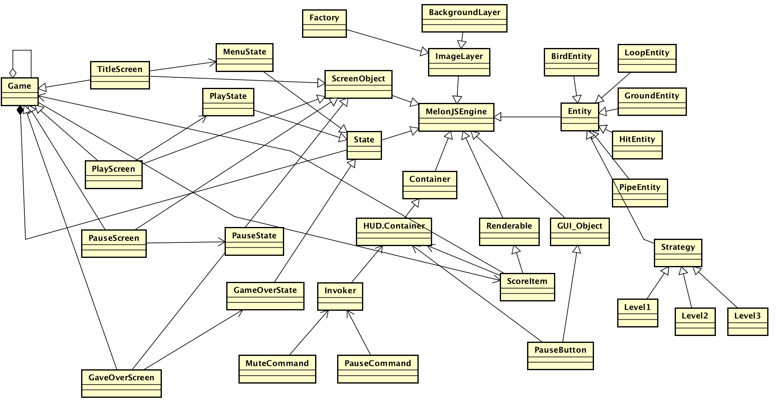
Class Diagram: Objects inherited from MelonJS Engine
https://github.com/nguyensjsu/cmpe202-loops/tree/master/Class-Diagram

Slide 5
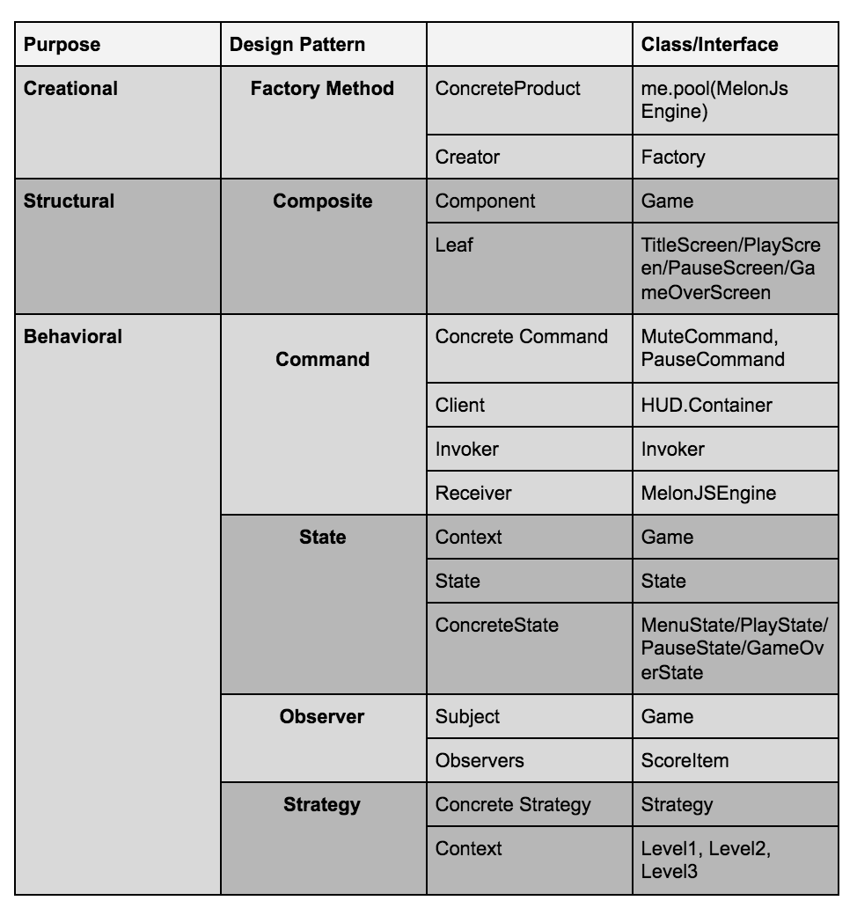
Design Patterns Implemented in the Game

Slide 6
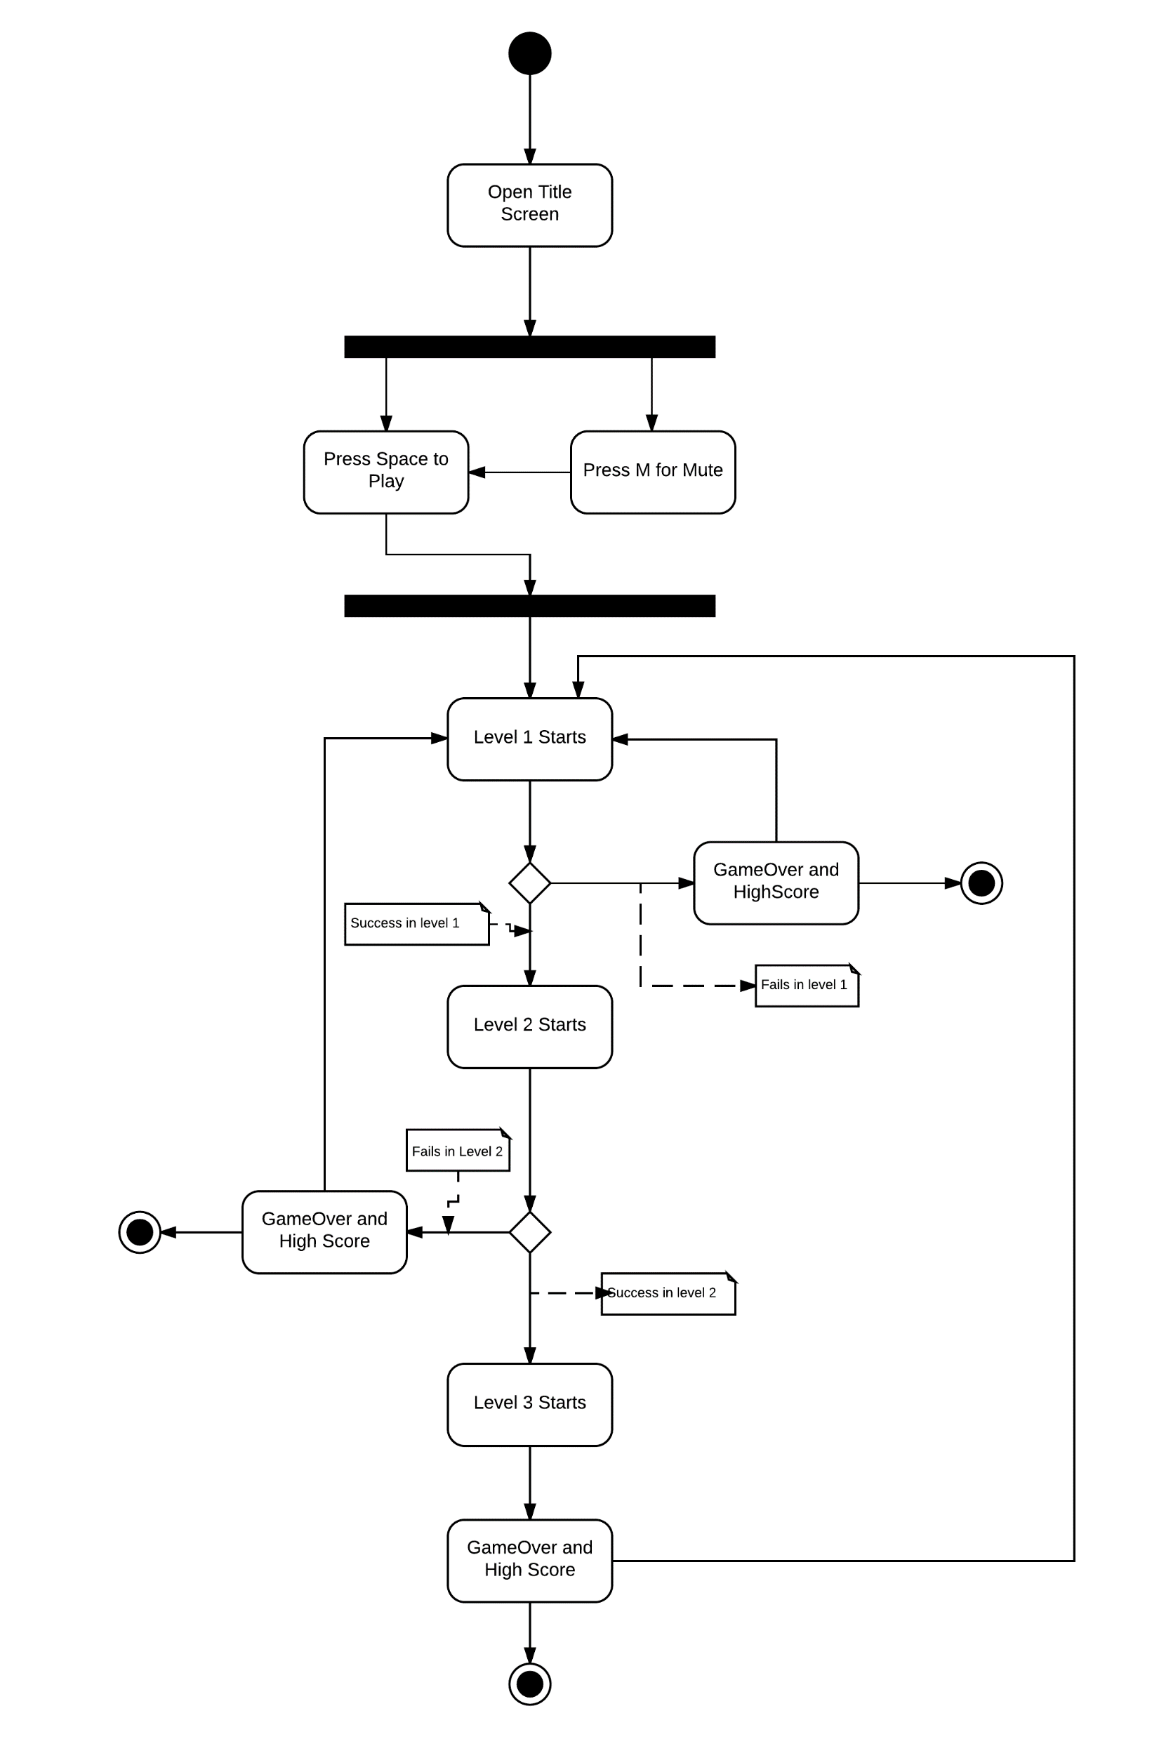
Activity Diagram
https://github.com/nguyensjsu/cmpe202-loops/blob/master/Activity%20Diagram%20Loops%20.png

Slide 7
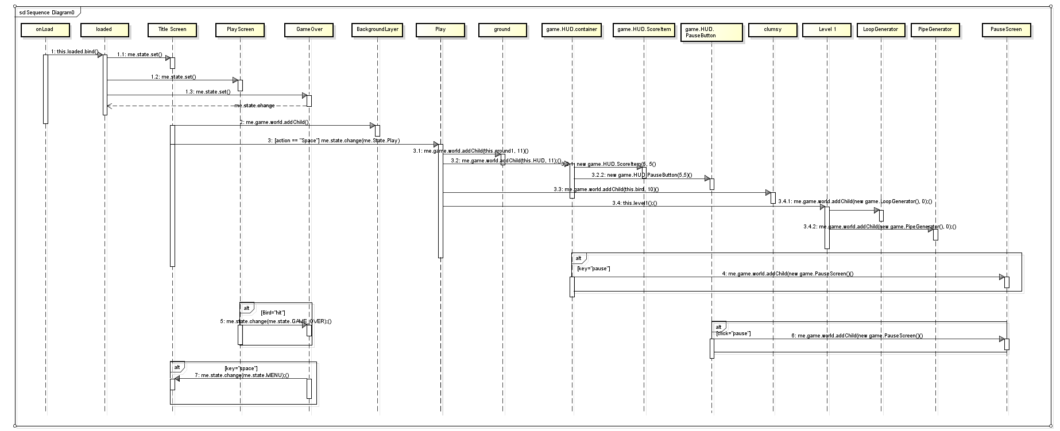
Sequence Diagram
https://github.com/nguyensjsu/cmpe202-loops/tree/3ce471770673b5e09e6aefb61968234477f157ab/sequence%20diagram

Slide 8
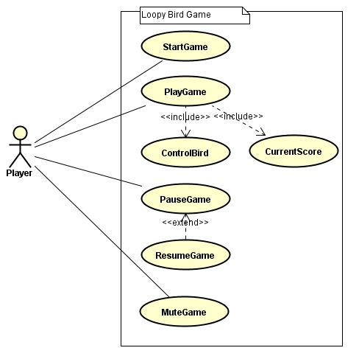
Use Case Diagram

Slide 9
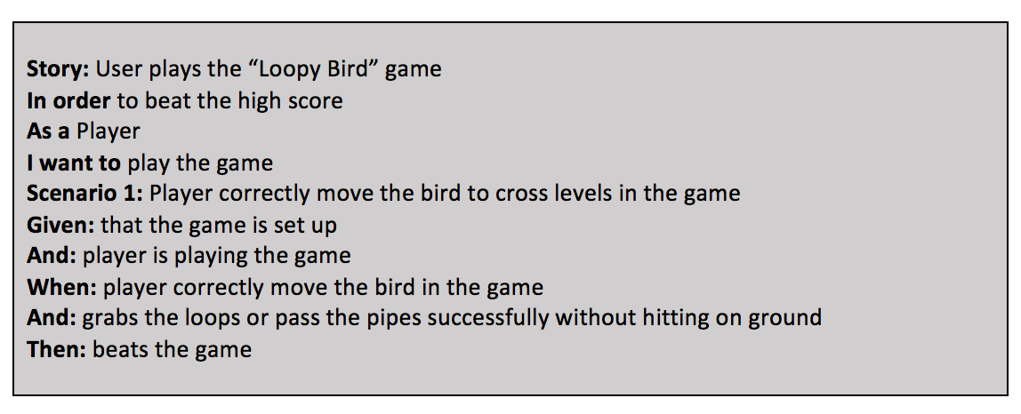
User Story-1
https://github.com/nguyensjsu/cmpe202-loops/blob/master/User-Story1.png

Slide 10
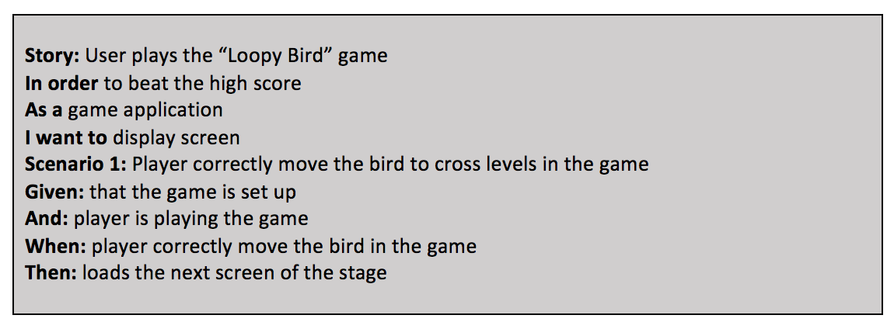
User Story-2
https://github.com/nguyensjsu/cmpe202-loops/blob/master/User-Story2.png

Slide 11
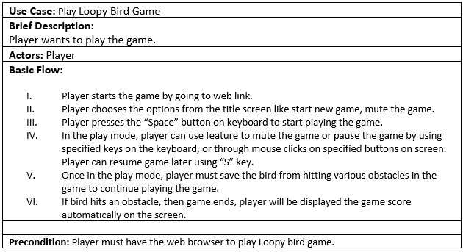
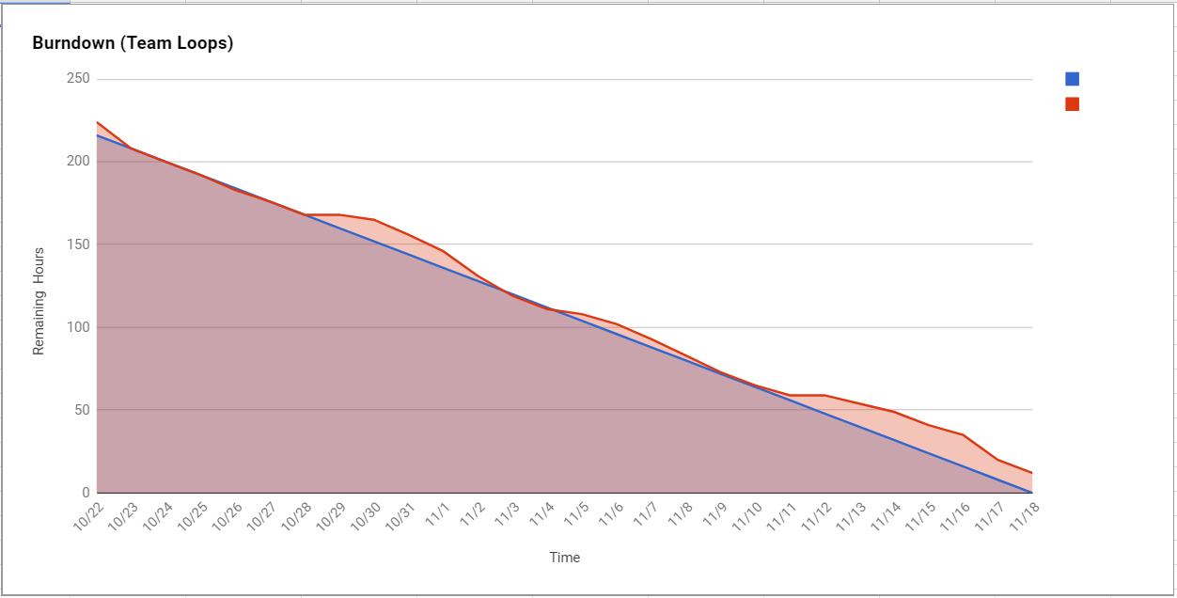
Use Case Specification

Slide 12
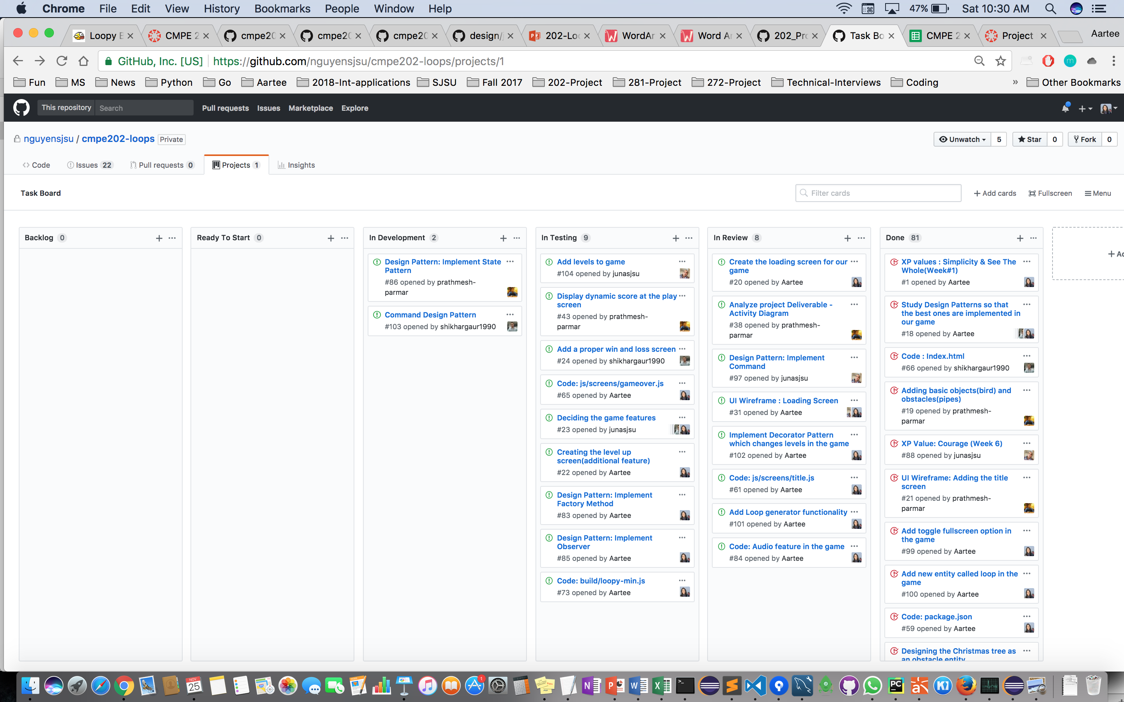
Final Task Board
https://github.com/nguyensjsu/cmpe202-loops/projects/1

Slide 13
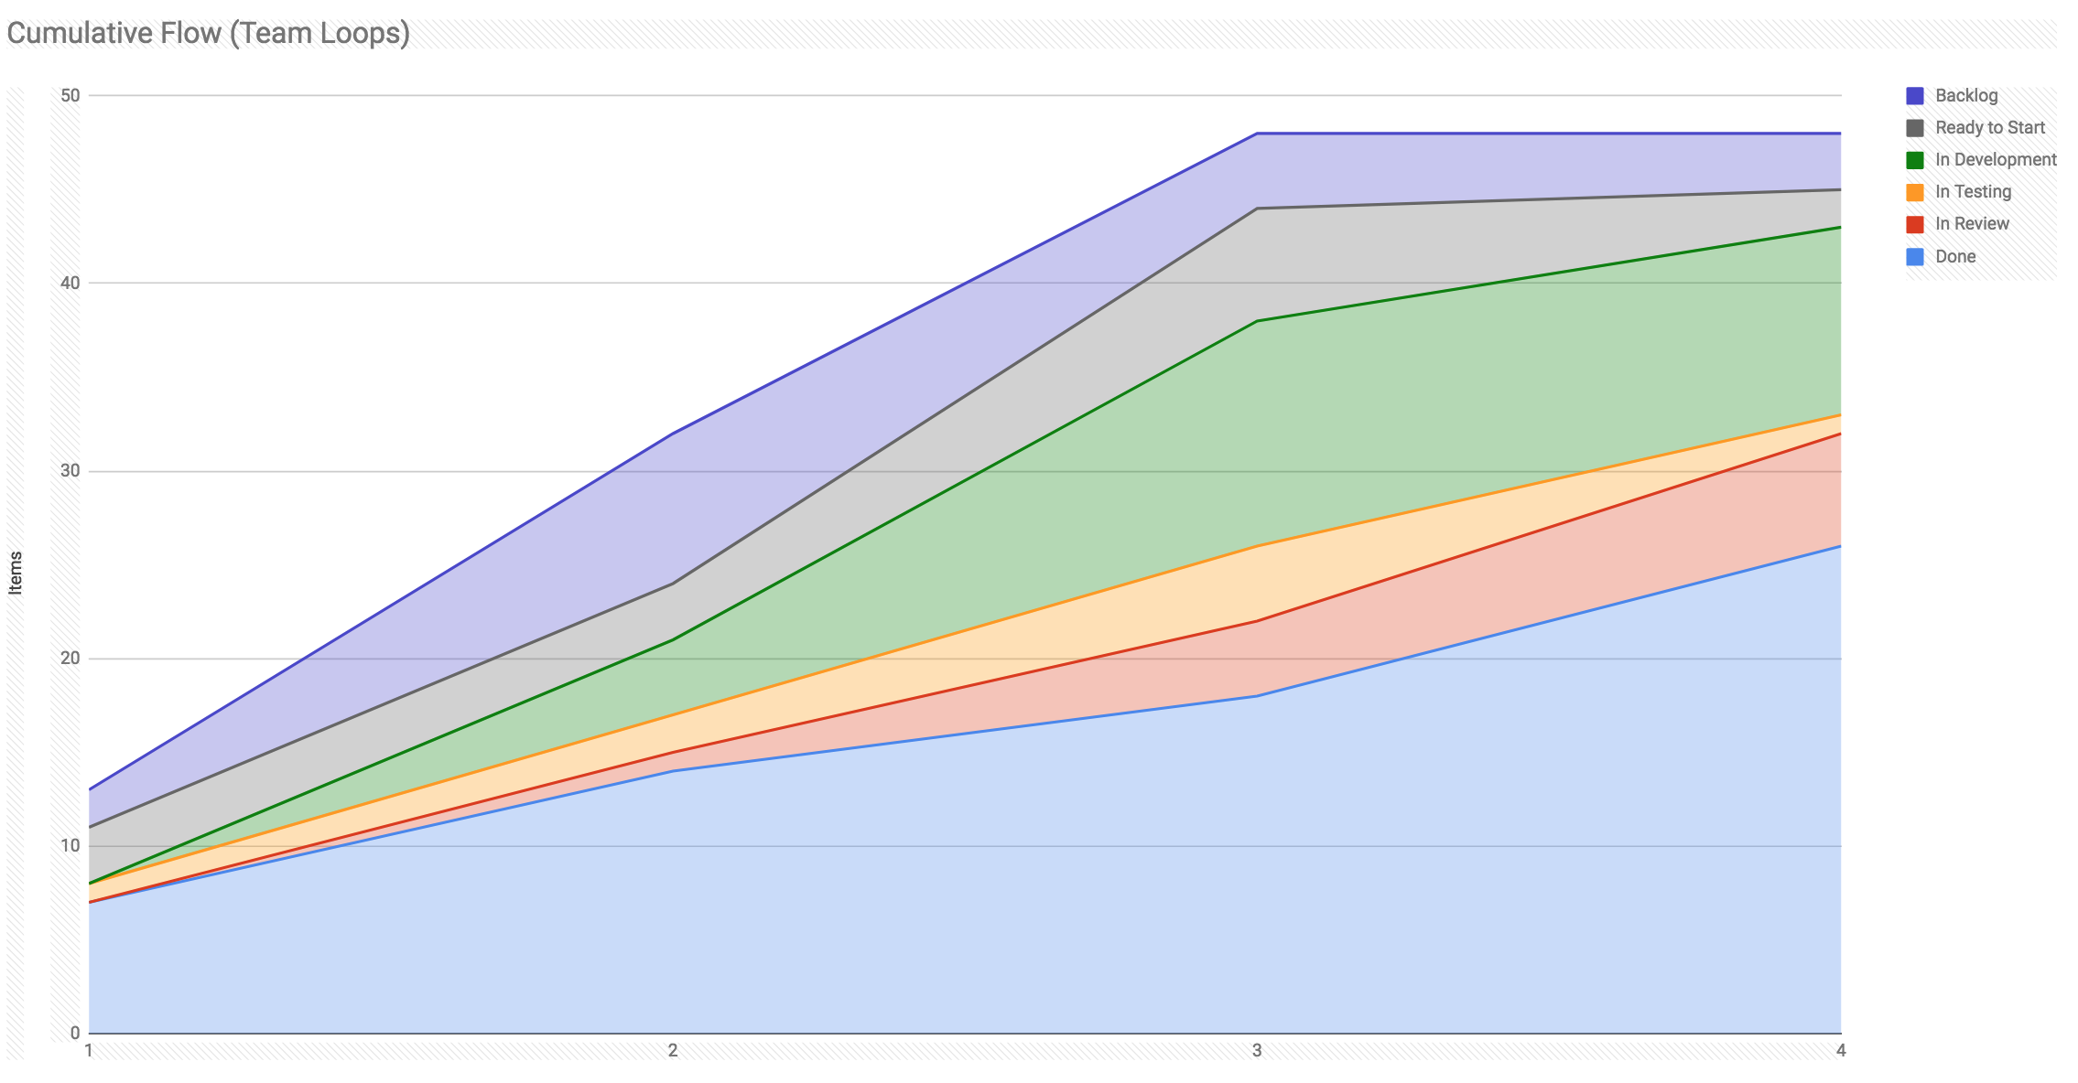
Cumulative Flow Diagram
https://docs.google.com/spreadsheets/d/1UmRQTEI2CiksiykI0AxxsgKBSQMjxMpq187mC-V3RS8/edit#gid=2

Slide 14
Burndown chart
https://docs.google.com/spreadsheets/d/1lMXWemXAj-7vbFc5gqzqQhYOF1j_ZS1fGVpb0VUqfik/edit#gid=0

Slide 15


Slide 16
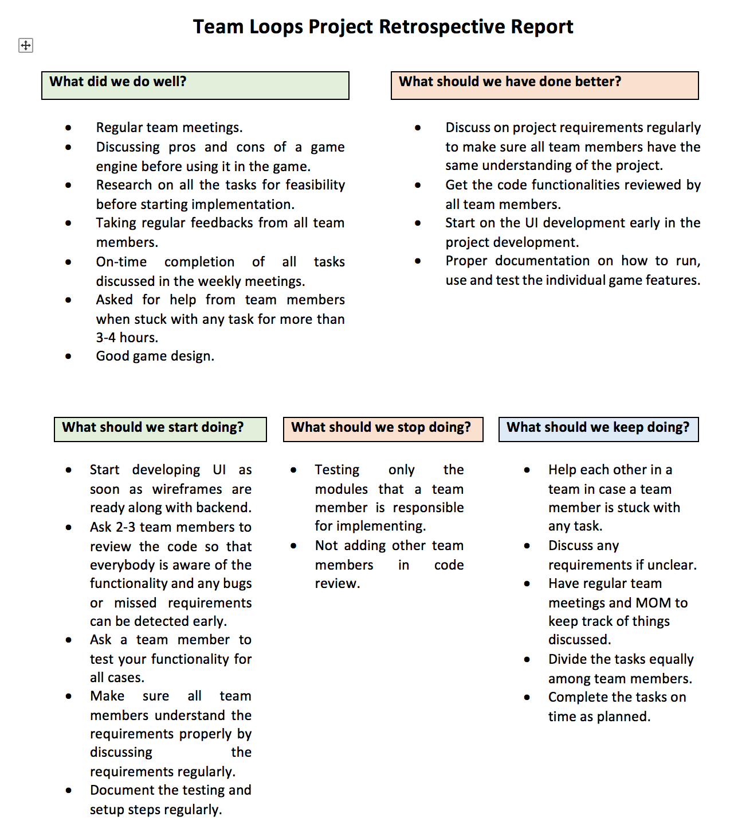
Loop Team's Retrospective Report
https://github.com/nguyensjsu/cmpe202-loops/blob/master/Team%20Retrospective%20Report.png

Slide 17

Scrum team
Scrum master:
Shikhar Gaur
Product Owner:
Prathmesh Parmar
Development team:
Junaid Khan
Aartee Kasliwal

Slide 18
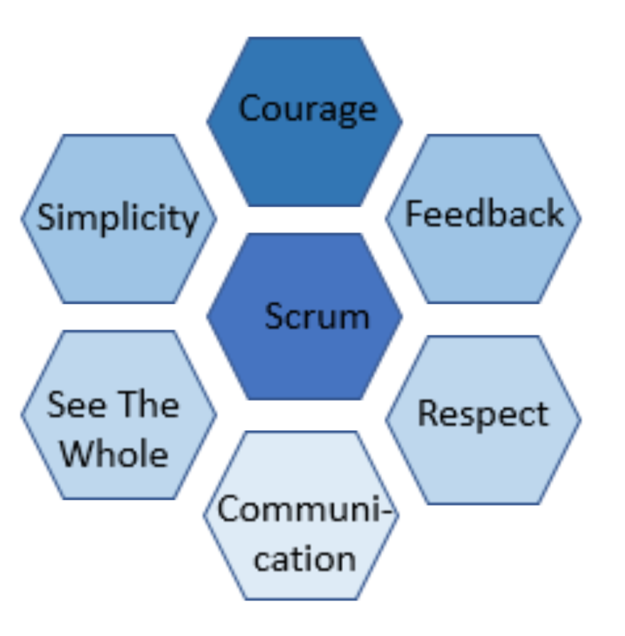
XP Core Values
https://github.com/nguyensjsu/cmpe202-loops/blob/master/Values.md

Slide 19

Sprint planning

Slide 20
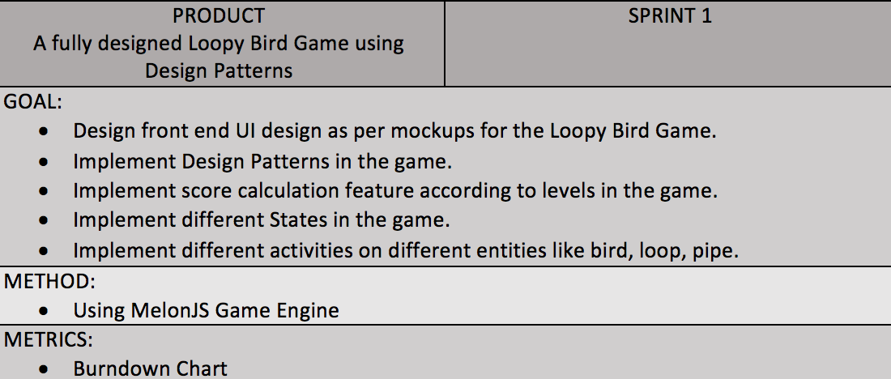
Sprint planning

Slide 21

Product Backlog Refinement

Slide 22
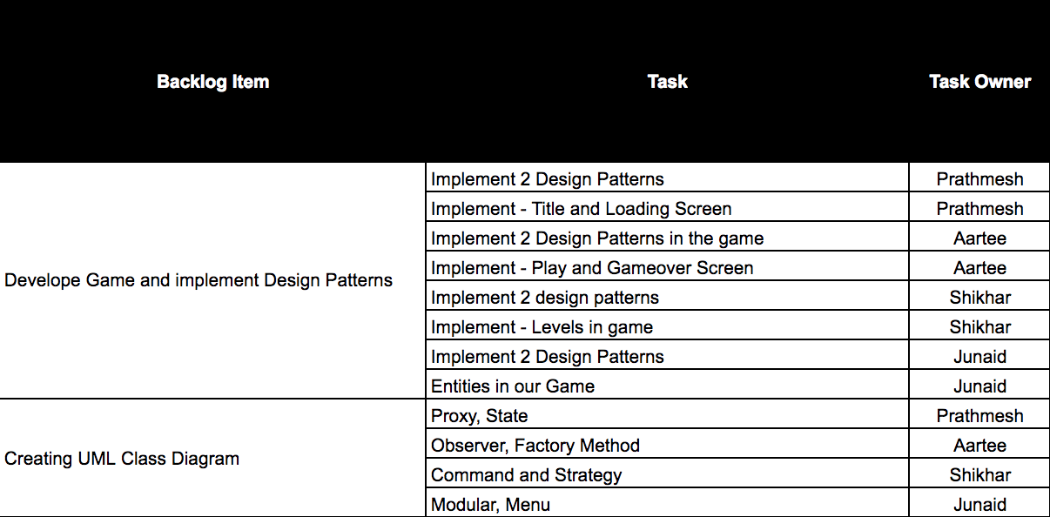
Backlog items

Slide 23


Weekly Standup

Slide 24
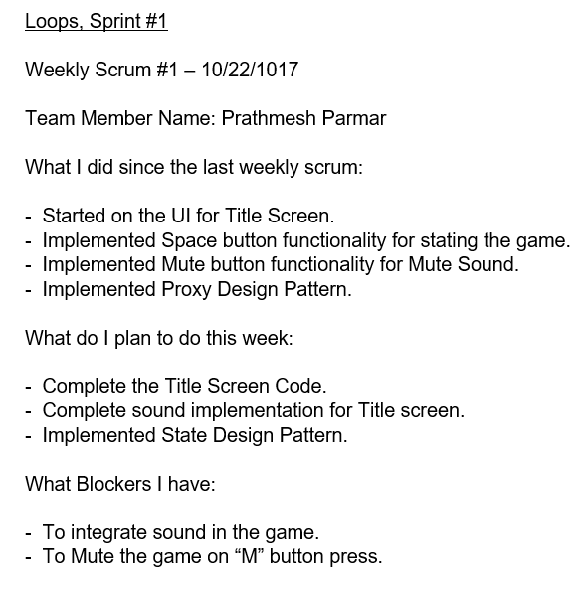
Week – 1
Standup

Slide 25
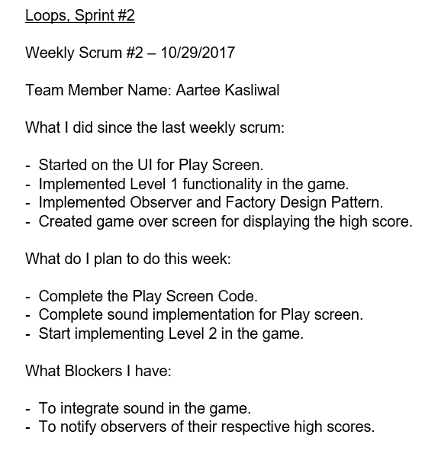
Week – 2 Standup

Slide 26
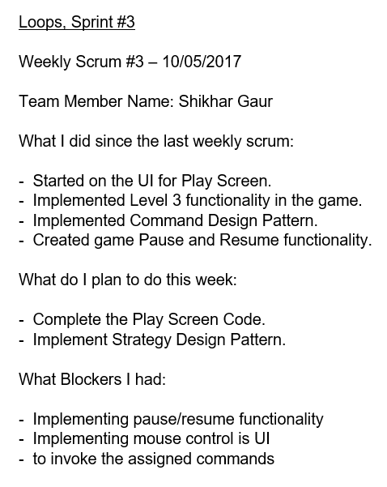
Week – 3 Standup

Slide 27
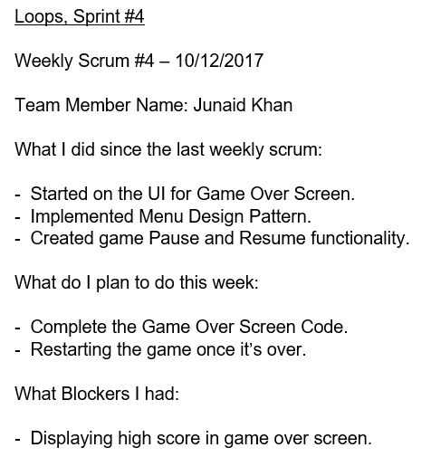
Week – 4 Standup

Slide 28
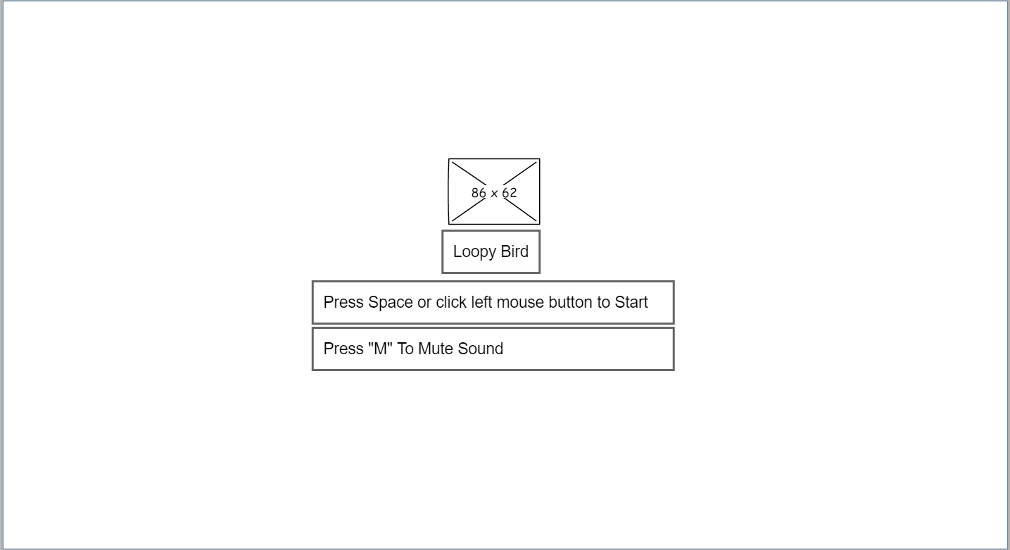
UI Wire Frames- Title Screen

Slide 29
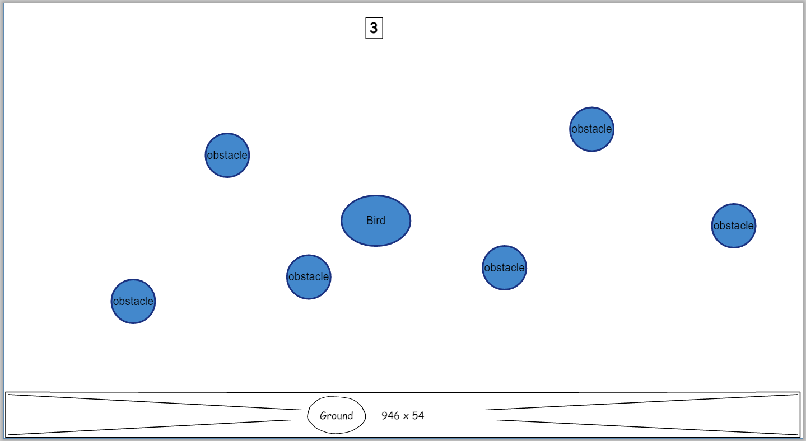
UI Wire Frames- Play Screen

Slide 30
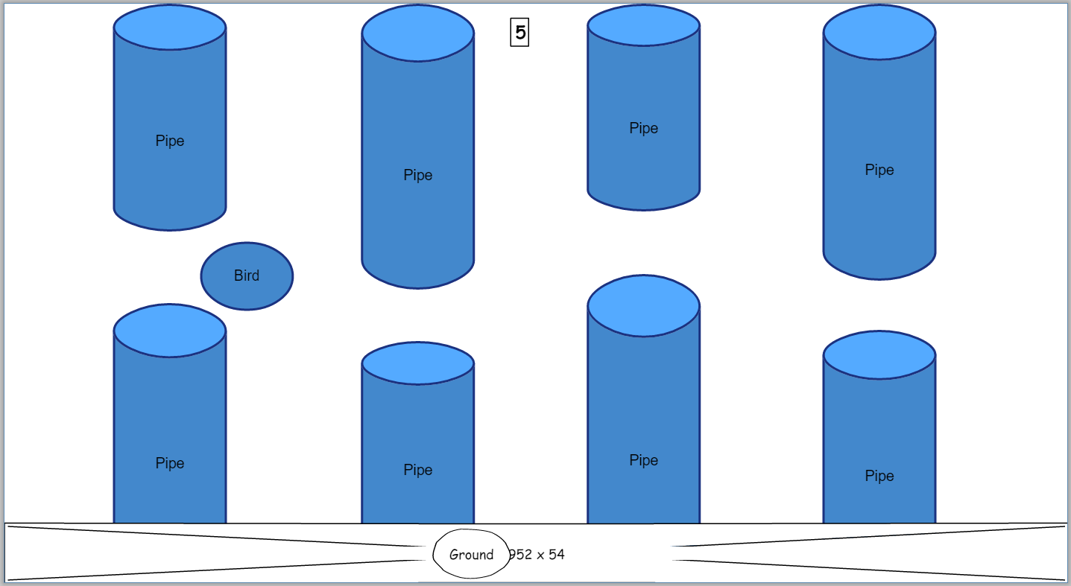
UI Wire Frames- Play Screen

Slide 31
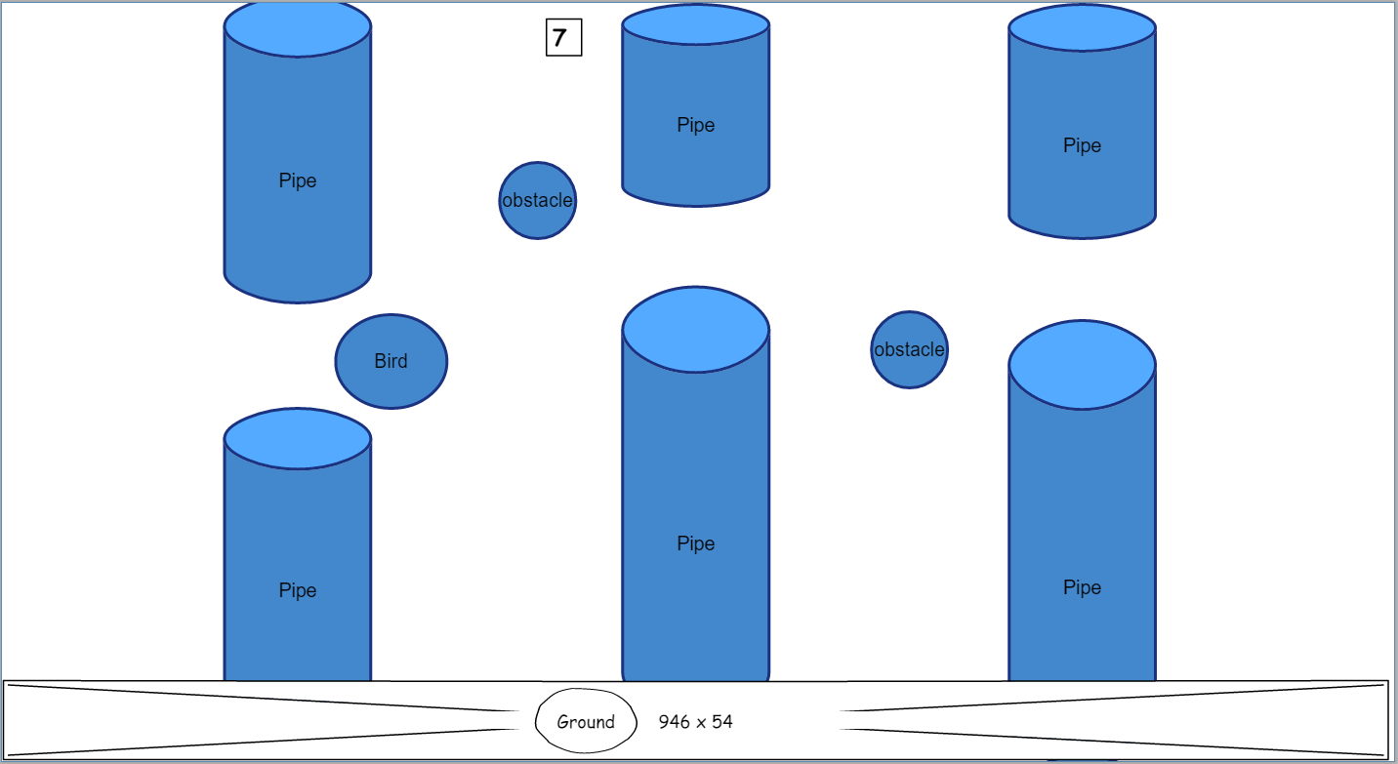
UI Wire Frames- Play Screen

Slide 32
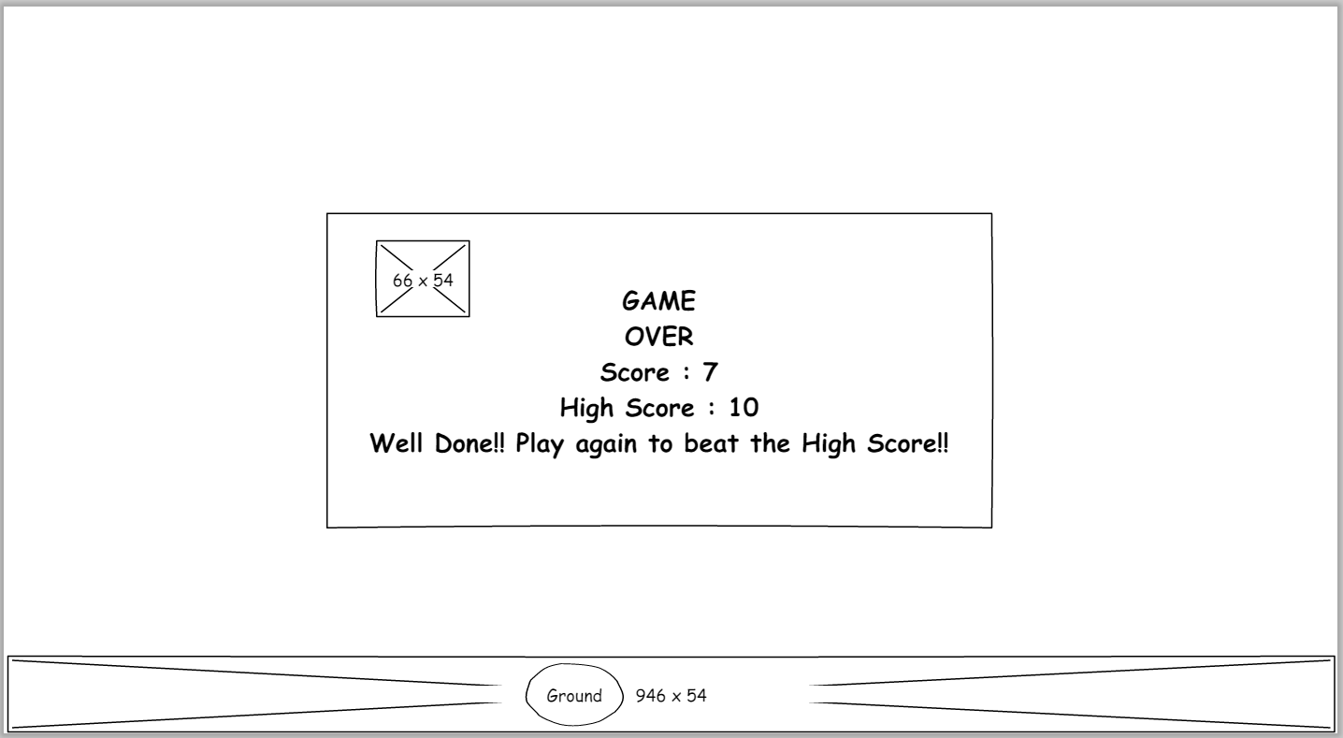
UI Wire Frames- Game Over

Slide 33

The Loopy Bird Game and the whole MelonJS world..

Slide 34
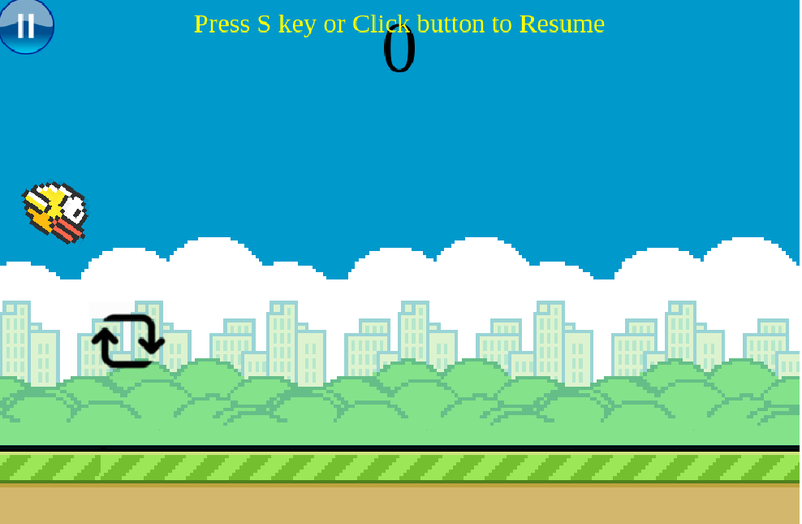
Level 1
Press space key to keep the bird flying
If bird touches the ground, the game is over
Player needs to collect loops to increase the score

Slide 35
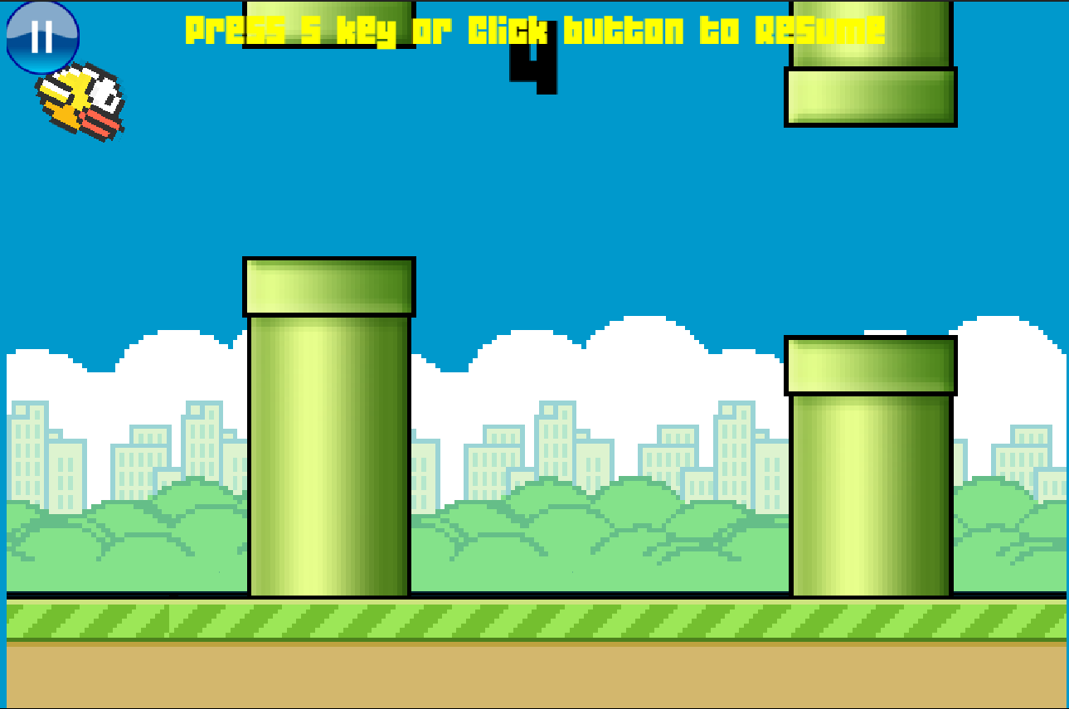
Level 2
After you achieve certain score in level 1, you enter level 2.
Keep flying by making sure you don't touch any of the pipes or the ground.
Your score keeps on incrementing when you pass through a pipe.

Slide 36
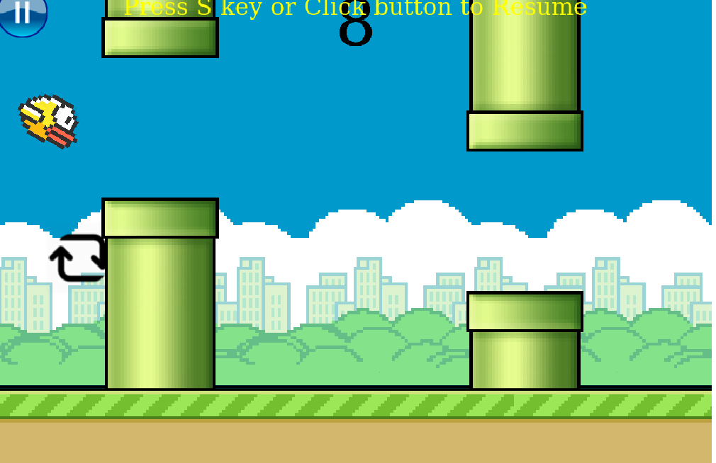
Level 3
This is the final stage in the game.
Collect the loops while carefully flying through the pipes.
The score increases when you collect a loop and pass through a pipe

Slide 37
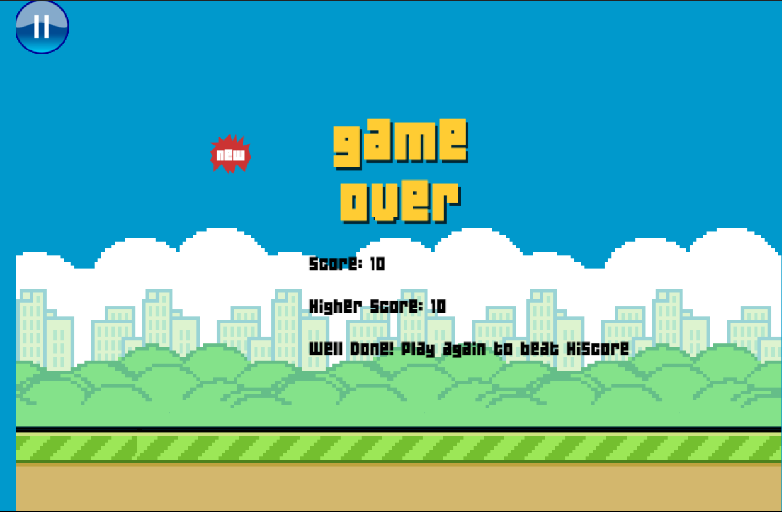
Game Over Screen
Oops! You hit the bird. If you get a high score, it will be displayed here. Press space to start all over again.

